Slide 1
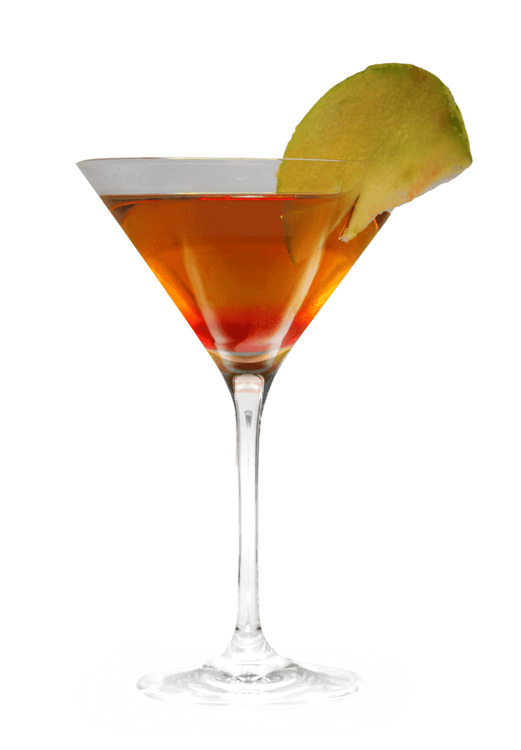
Where should i go party?
Which is more chaotic among LA, NYC, LONDON, MILAN and BARCELONA?

Slide 2
LOS ANGELES
NUMBER OF Nightspots
135

Slide 3
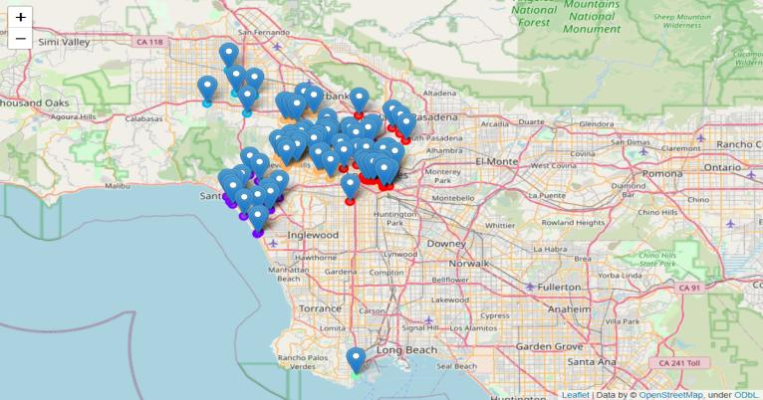

Slide 4
New york city
Number of nightspots
193

Slide 5
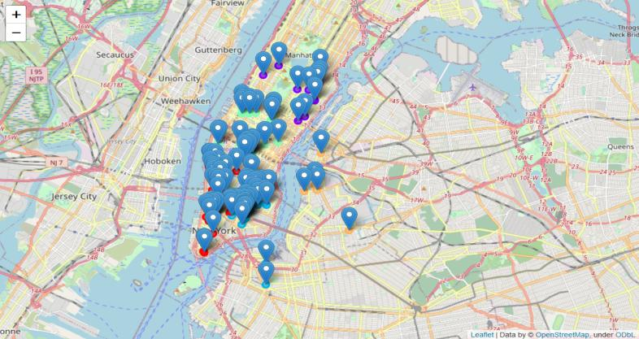

Slide 6
LONDON
NUMBER OF NIGHTSPOTS
118

Slide 7
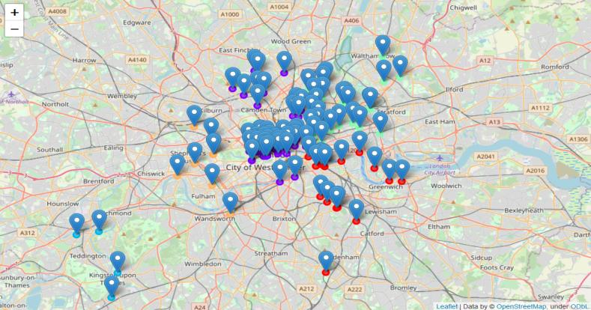

Slide 8
MILAN
NUMBER OF NIGHTSPOTS
101

Slide 9
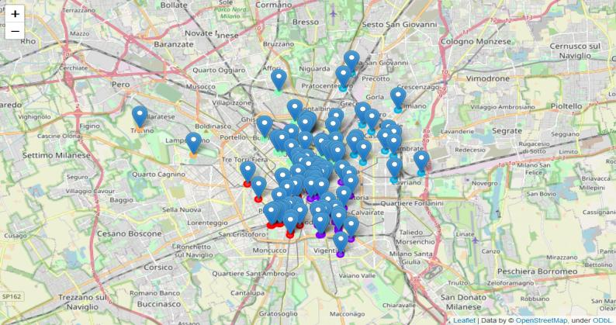

Slide 10
barcelona
Number of nightspots

Slide 11
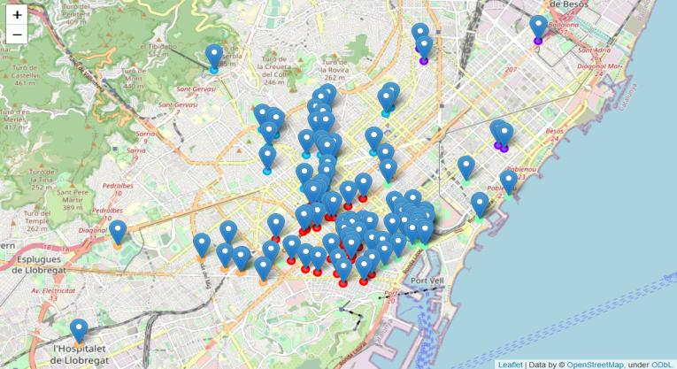

Slide 12
The best place where to party is…

Slide 13
…NEW YORK!
NoT ONLY NEW YORK HAS THE HIGHEST NUMBER OF NIGHTSPOTS, BUT ALSO THEY ARE ALL CLOSE TO EACH OTHER!

Slide 14
HOWEVER, IF YOU DECID TO GO ELSEWHERE…
LOS ANGELES: BOOK AN HOTEL IN THE MIDDLE BETWEEN DOWNTOWN LOS ANGELES AND WEST LOS ANGELES
LONDON: BOOK AN HOTEL IN THE CENTER OF THE CITY… THERE IS PLENTY OF BARS THERE
MILAN: BOOK A PLACE IN THE CENTER OF THE CITY… YOU WILL FIND A HIGH DENSITY OF NIGHSPOTS THERE
BARCELONA: go party near the barceloneta!

Slide 15
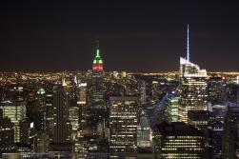
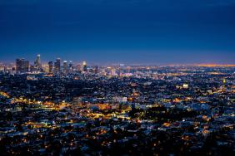
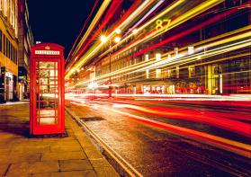
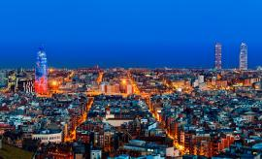
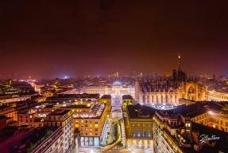
HAVE A NICE TRIP!

